Slide 1
Julia Fractals
By: Jake VanZyverden

Slide 2
The Squaring map
When mapped to a unit circle this map is chaotic, and the basis for the julia set.
Q₀(z) = z²

Slide 3
The Julia Set
Adding a complex number as a constant to the squaring map we create the julia set.
Q₀(z) = z² + c

Slide 4
The Julia Set
When mapping the julia set where
c ≠ 0, -2 we see self similar fractal like designs.
Q₀(z) = z² + c

Slide 5
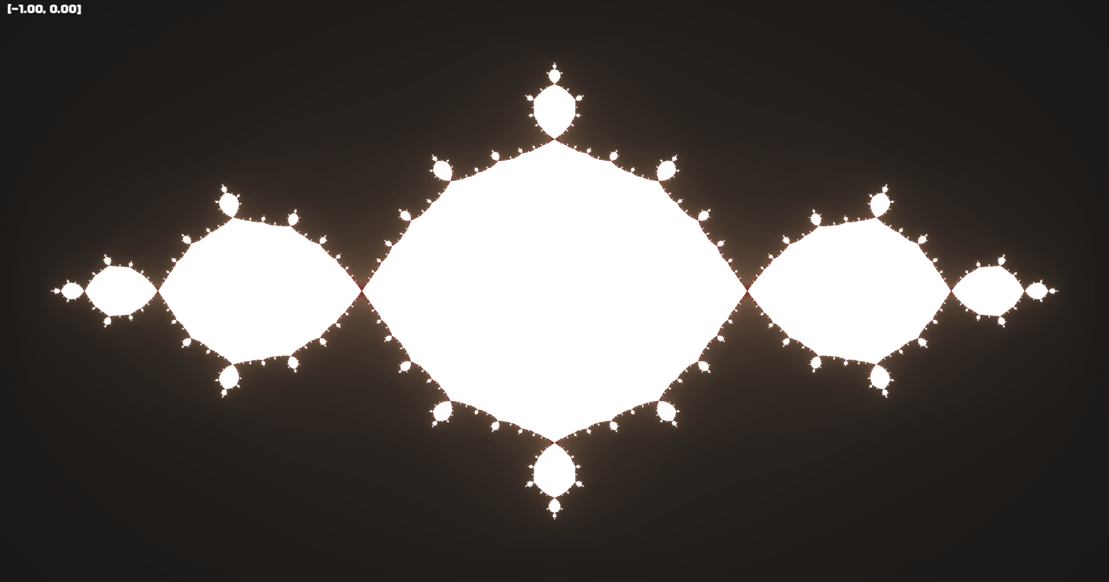
The Julia Set
Q₀(z) = z² + c
C = -1.0 + 0.0i (max_iter = 500)

Slide 6
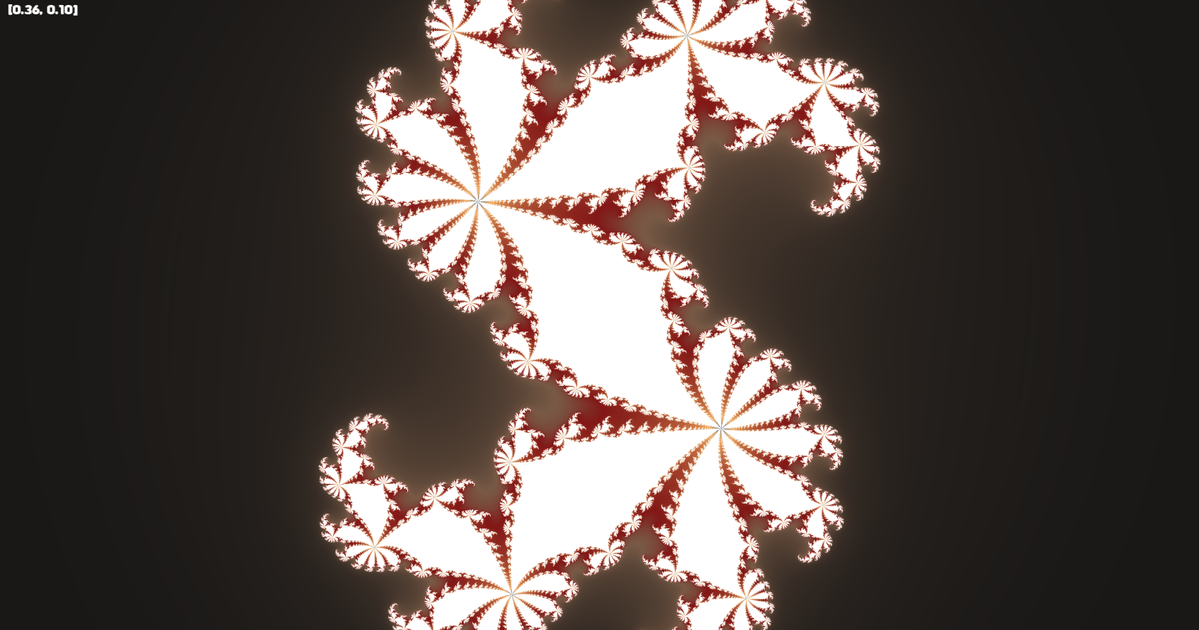
The Julia Set
Q₀(z) = z² + c
C = 0.360284 + 0.100376i (max_iter = 250)

Slide 7
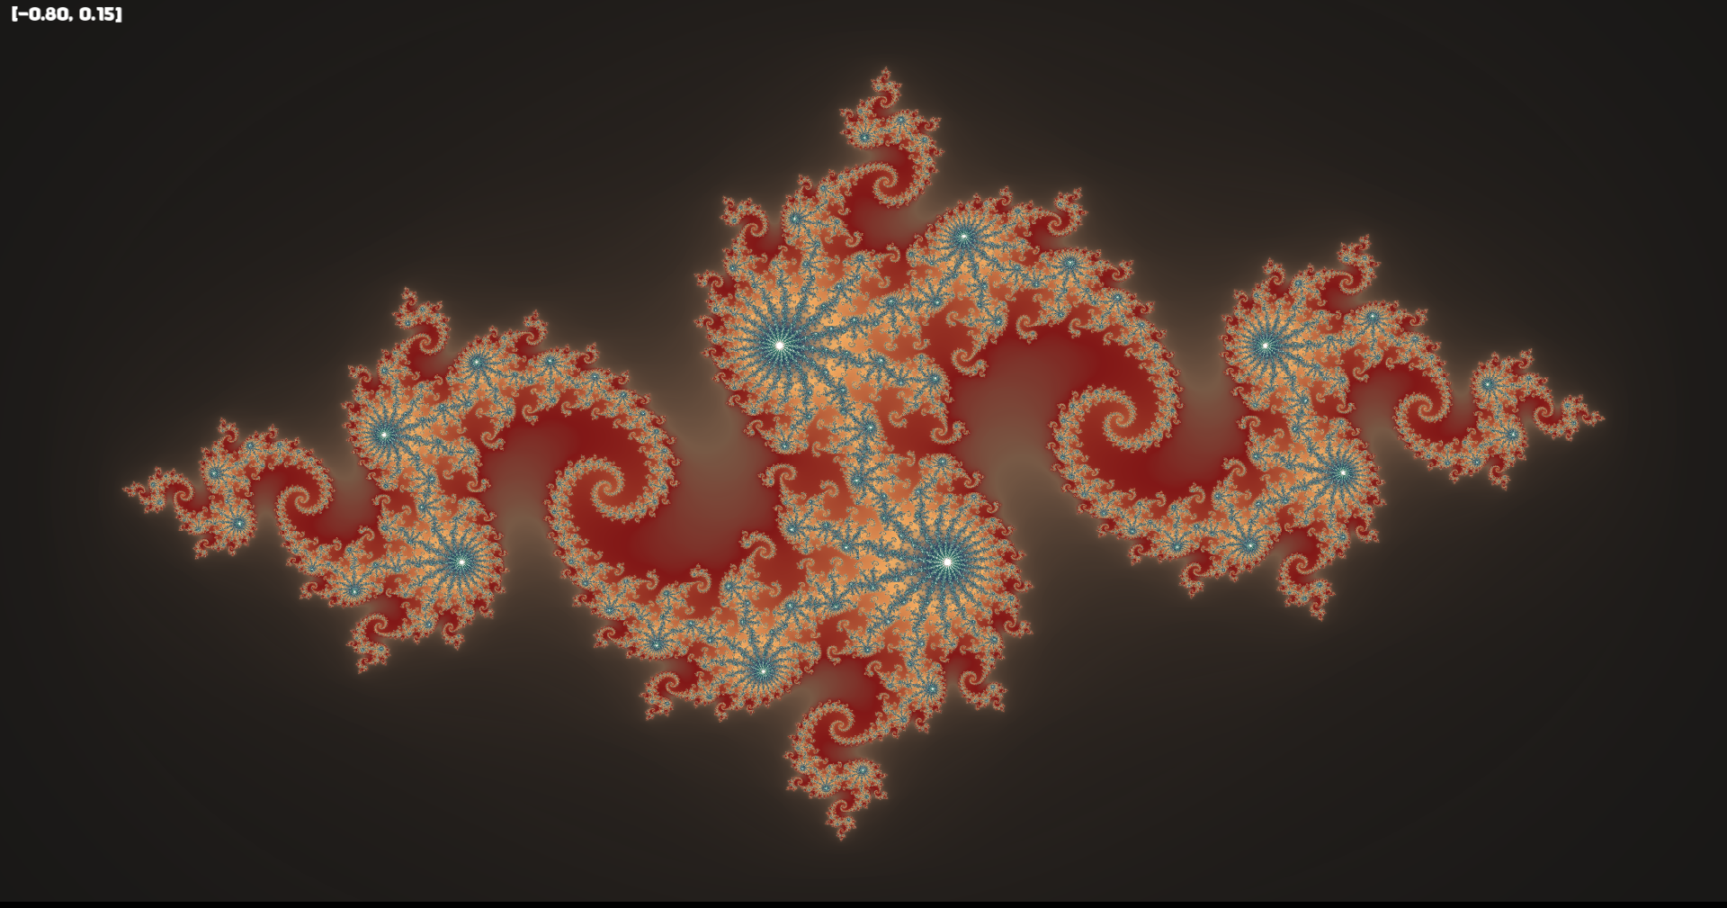
The Julia Set
Q₀(z) = z² + c
C = -0.8 + 0.15i (max_iter = 500)

Slide 8
Properties of the Julia Set (Critical Orbits)
Bounded & Connected
Unbounded & Shattered

Slide 9
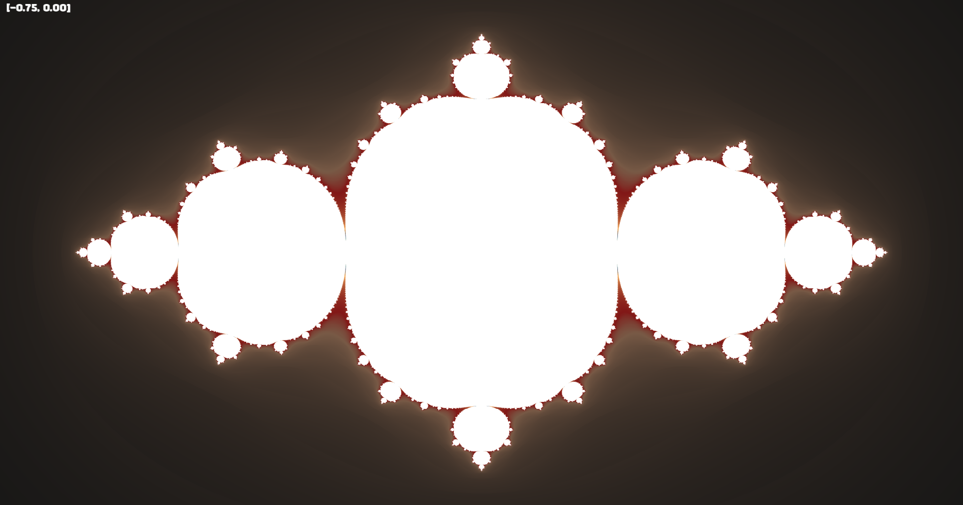
Properties of the Julia Set (Critical Orbits)
Bounded & Connected
Unbounded & Shattered
Orbit of 0 is bounded within the frame and cannot escape to infinity.
C = -0.75 + 0.0i (max_iter = 250)

Slide 10
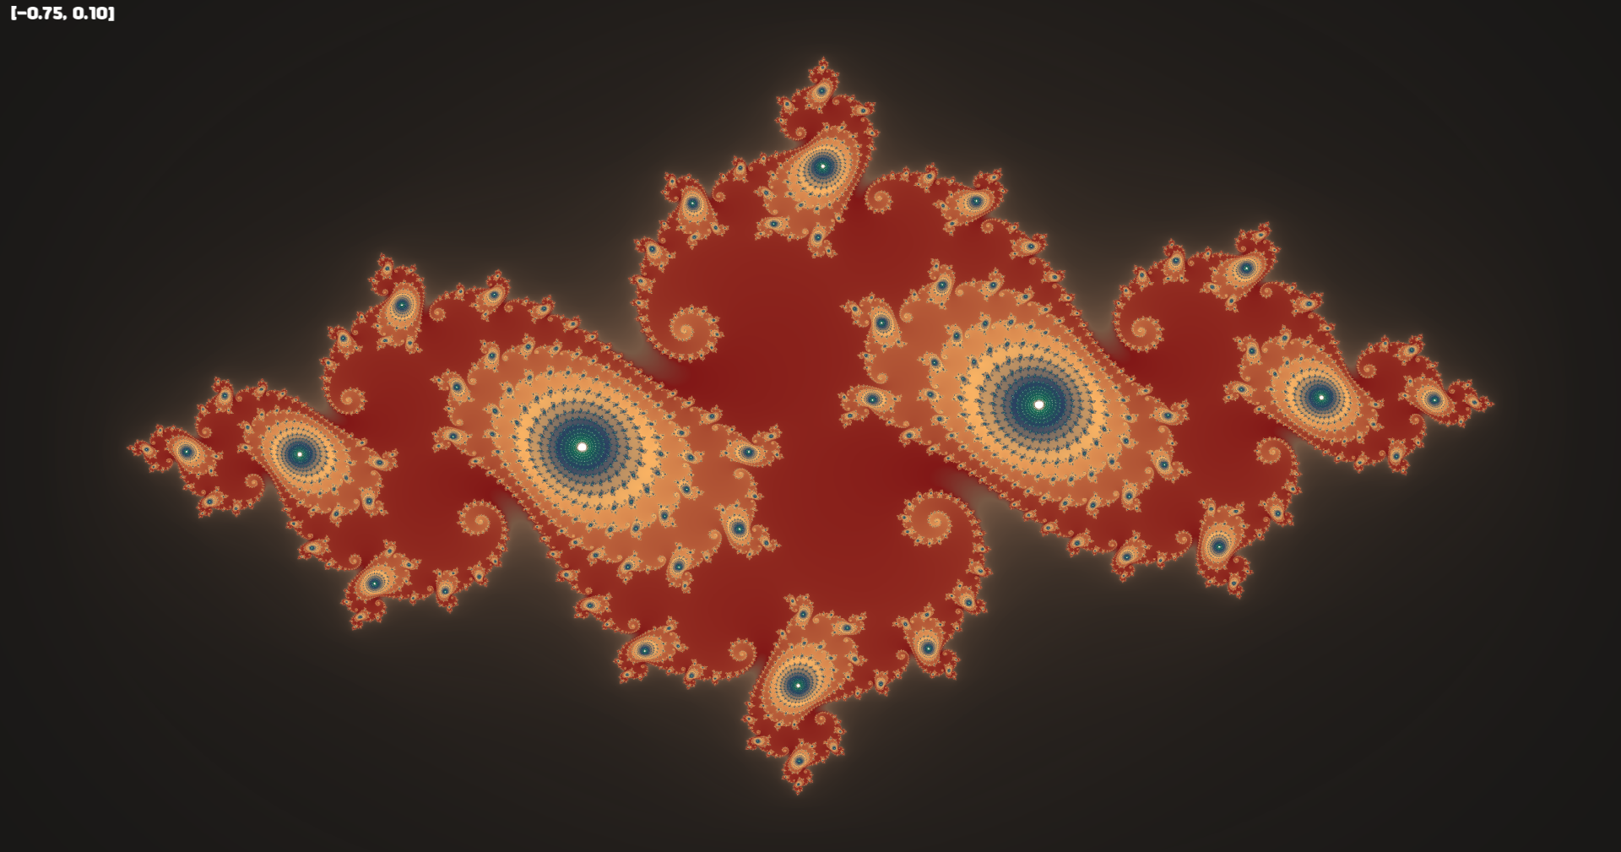
Properties of the Julia Set (Critical Orbits)
Bounded & Connected
Unbounded & Shattered
Orbit of 0 escapes to infinity before max iterations.
C = -0.75 + 0.1i (max_iter = 500)

Slide 11
Code Review
Gradients
Julia iteration functions
  Rough iterates
  Smooth iterates
Anti-aliasing
Optimization

Slide 12
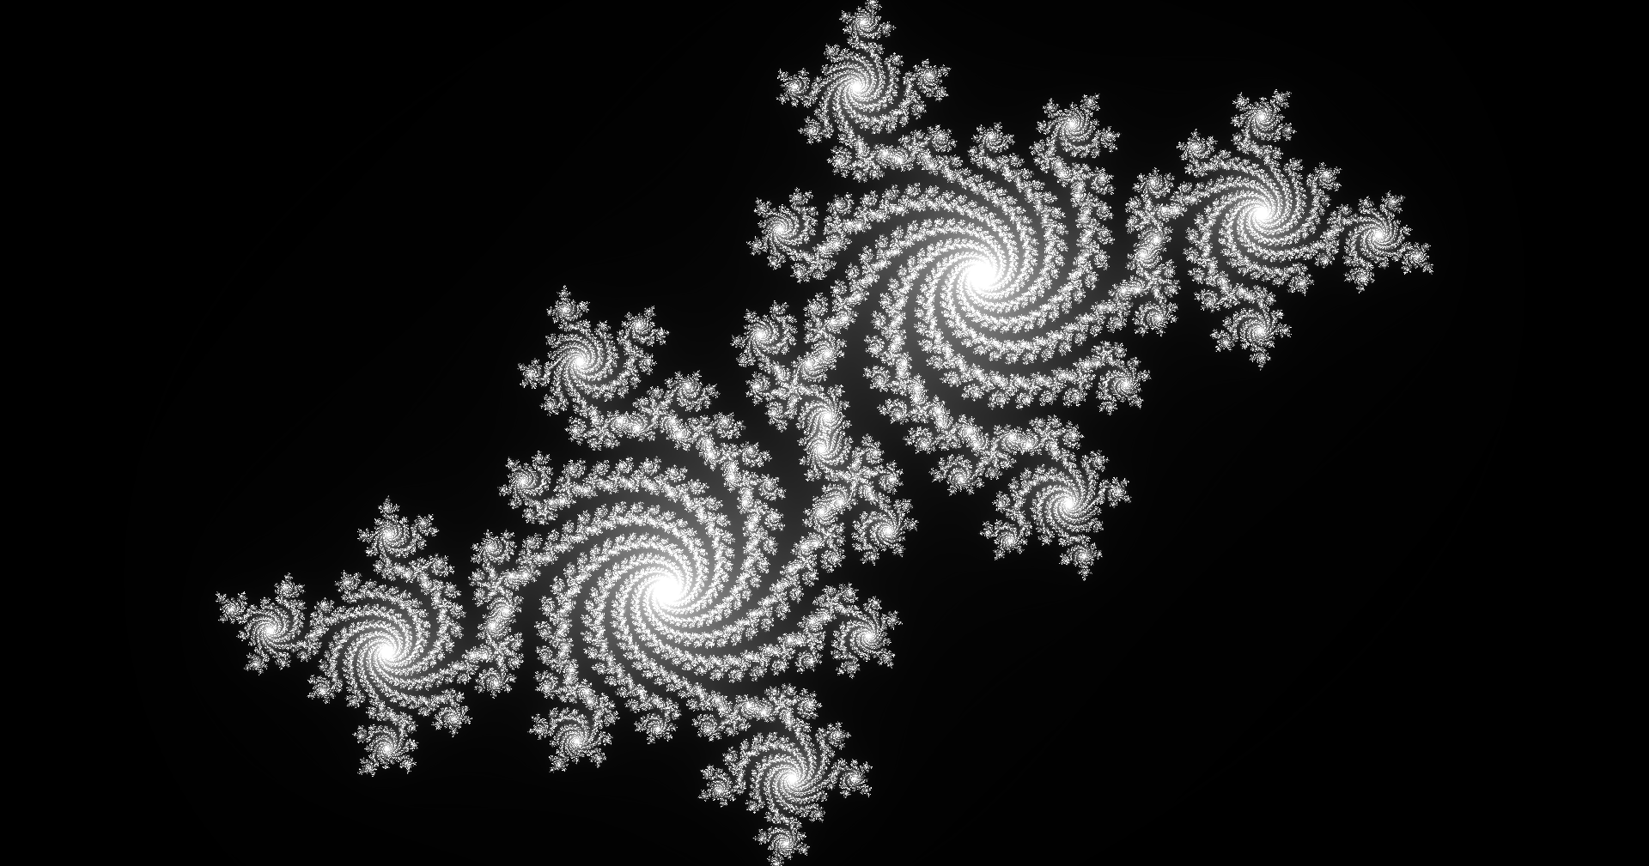
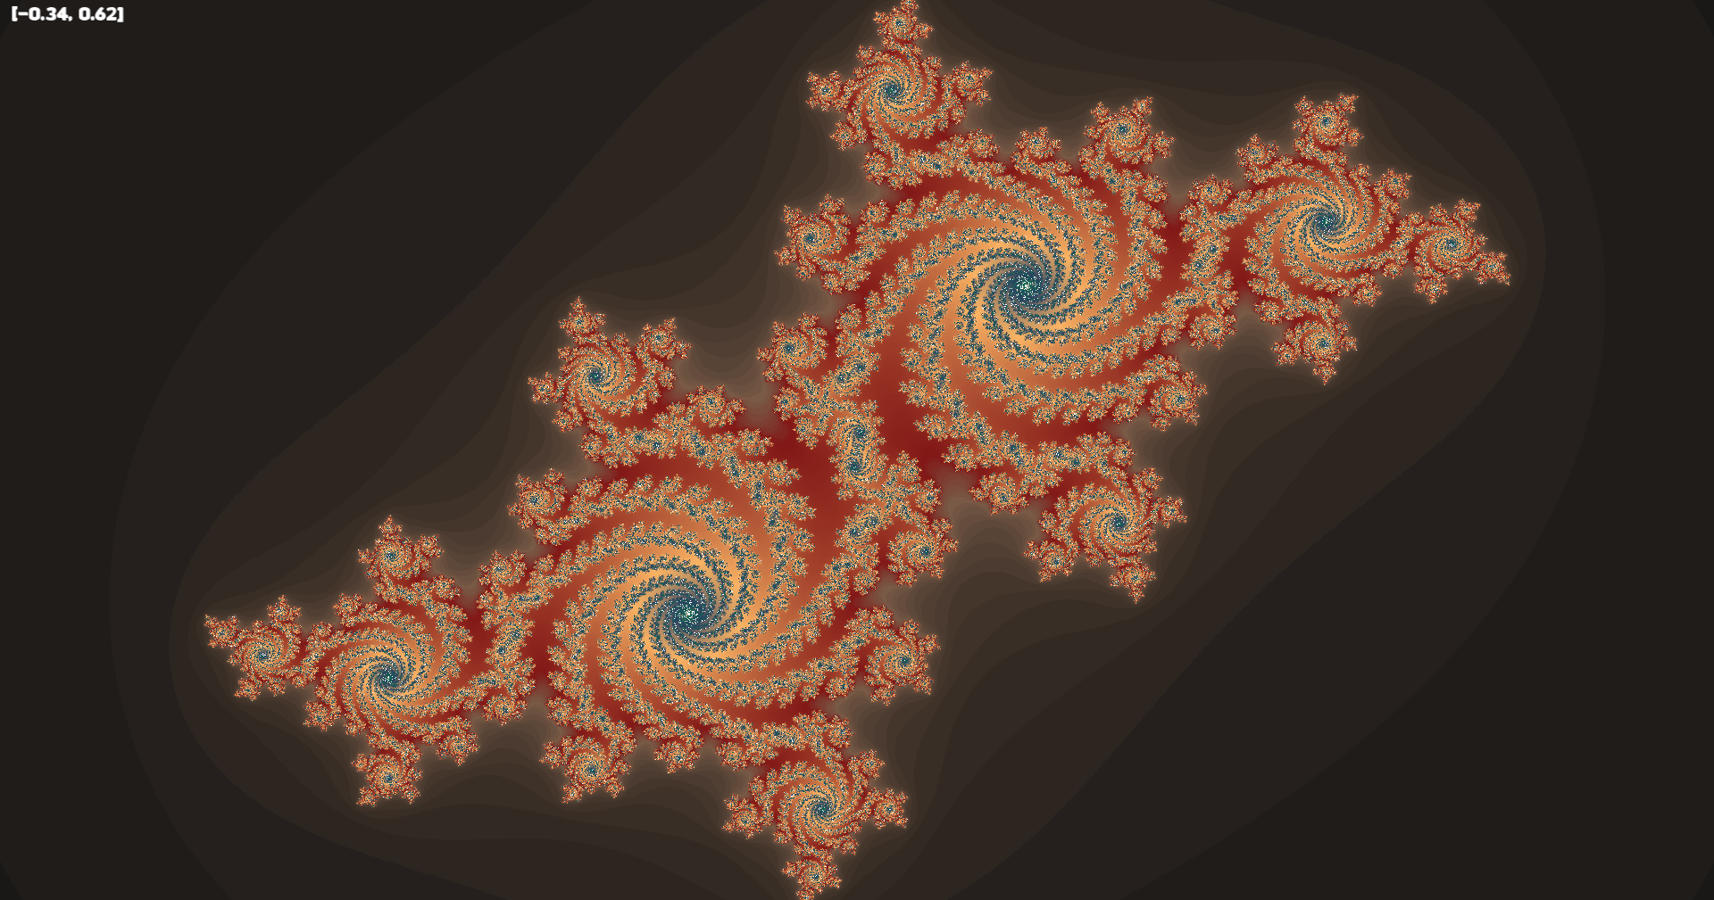
Code Review
Gradients
Julia iteration functions
  Rough iterates
  Smooth iterates
Anti-aliasing
Optimization

Slide 13
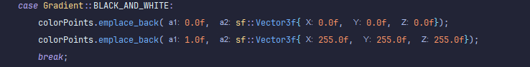
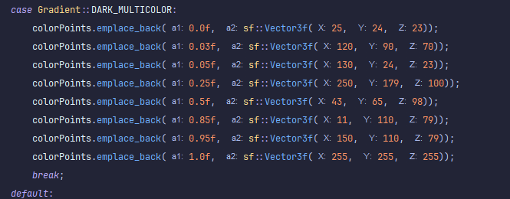
Code Review
Gradients
Julia iteration functions
  Rough iterates
  Smooth iterates
Anti-aliasing
Optimization

Slide 14
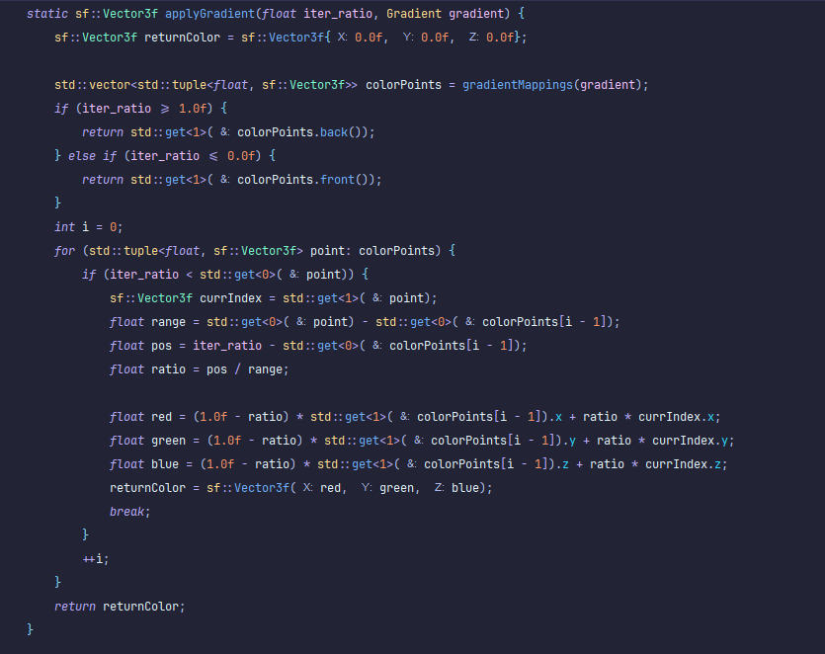
Code Review
Gradients
Julia iteration functions
  Rough iterates
  Smooth iterates
Anti-aliasing
Optimization

Slide 15
Code Review
Gradients
Julia iteration functions
  Rough iterates
  Smooth iterates
Anti-aliasing
Optimization

Slide 16
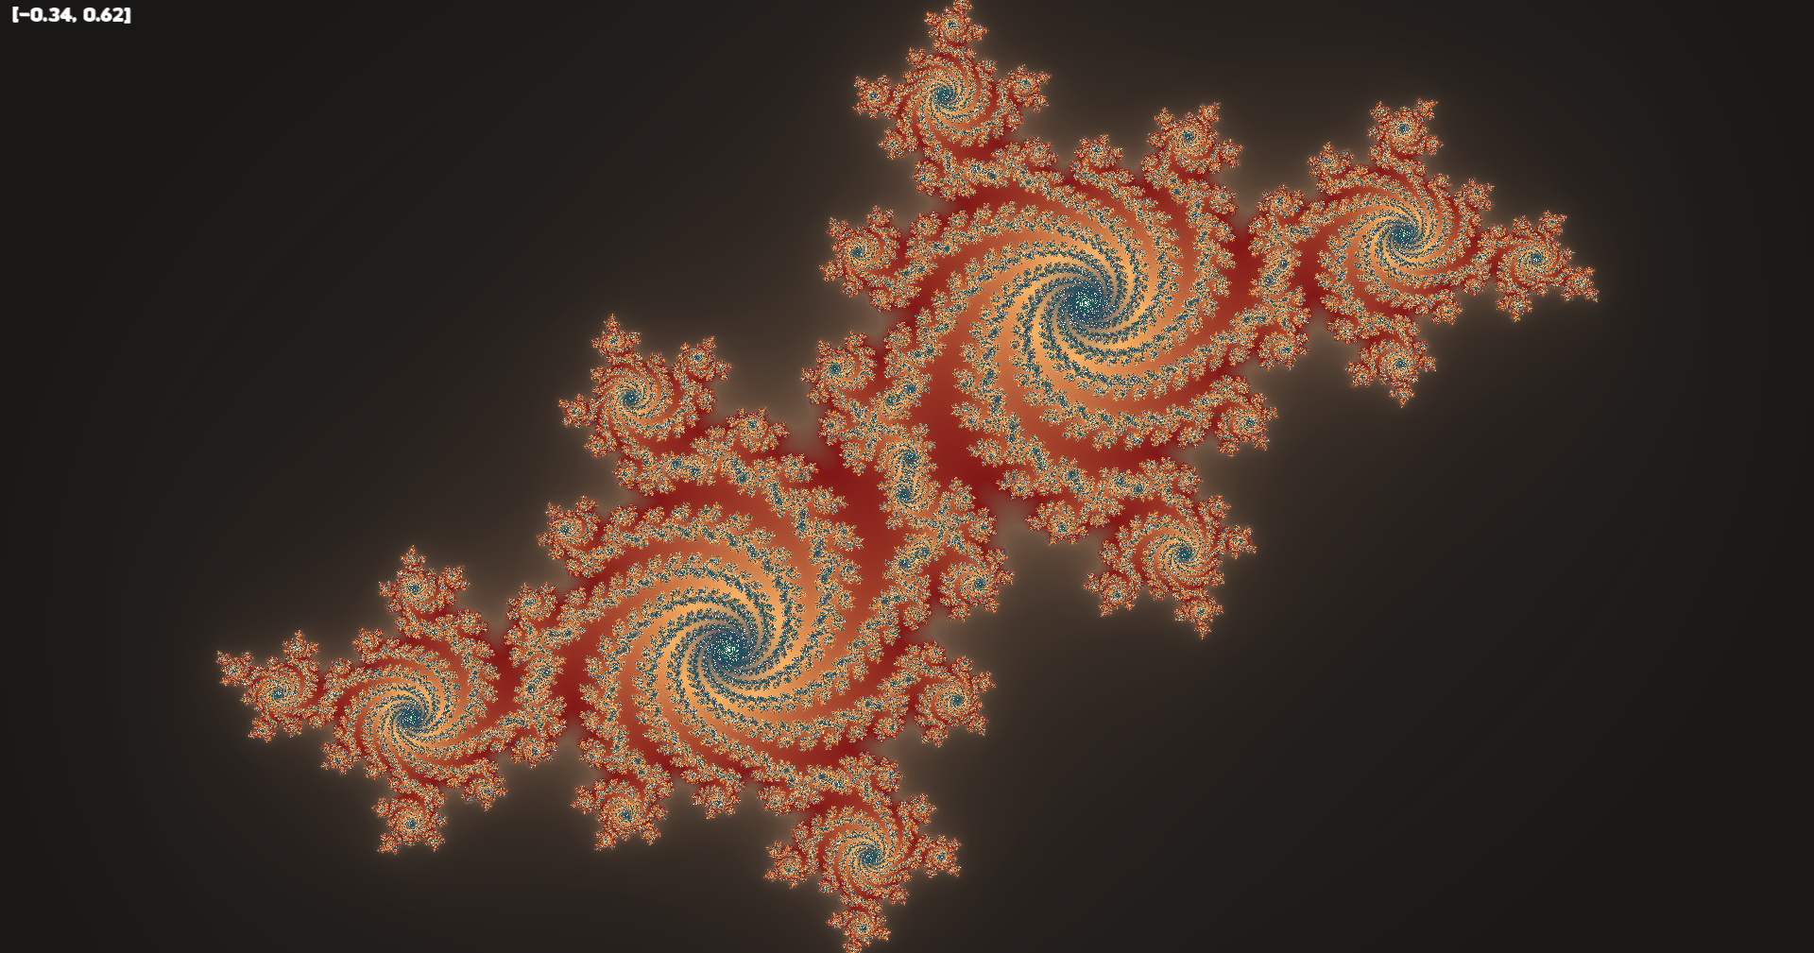
Code Review
Gradients
Julia iteration functions
  Rough iterates
  Smooth iterates
Anti-aliasing
Optimization

Slide 17
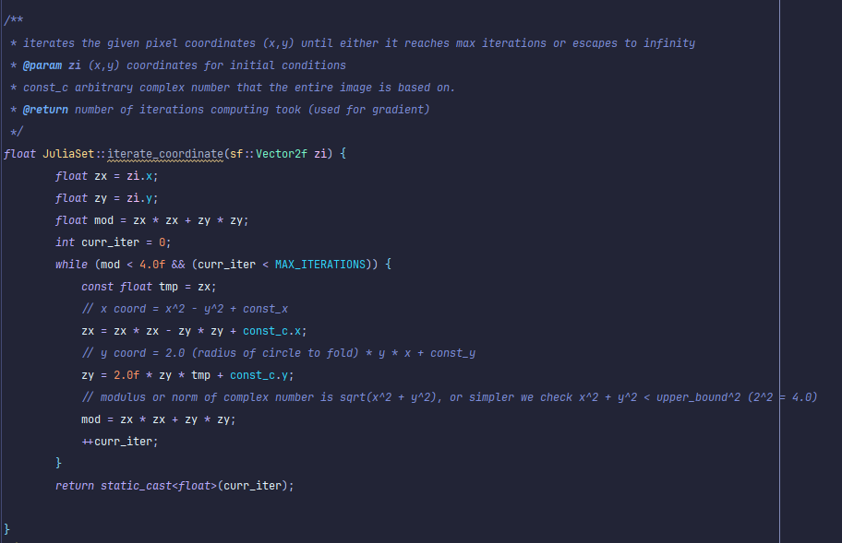

Code Review
Gradients
Julia iteration functions
  Rough iterates
  Smooth iterates
Anti-aliasing
Optimization

Slide 18
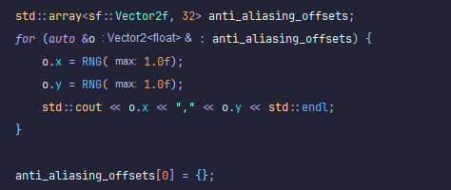
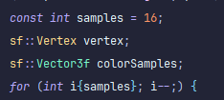

Code Review
Gradients
Julia iteration functions
  Rough iterates
  Smooth iterates
Anti-aliasing
Optimization

Slide 19
Code Review
Gradients
Julia iteration functions
  Rough iterates
  Smooth iterates
Anti-aliasing
Optimization

Slide 20
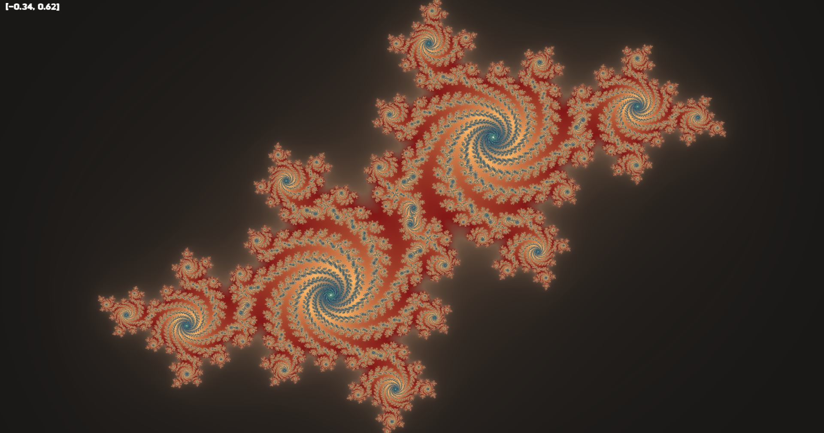
Code Review
Gradients
Julia iteration functions
  Rough iterates
  Smooth iterates
Anti-aliasing
Optimization

Slide 21
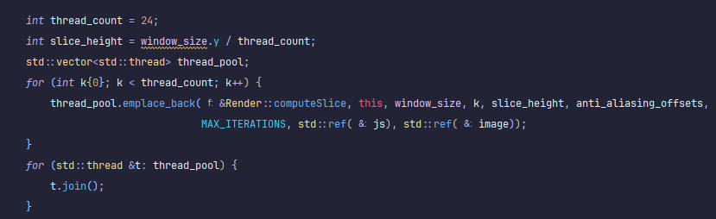
Code Review
Gradients
Julia iteration functions
  Rough iterates
  Smooth iterates
Anti-aliasing
Optimization

Slide 22
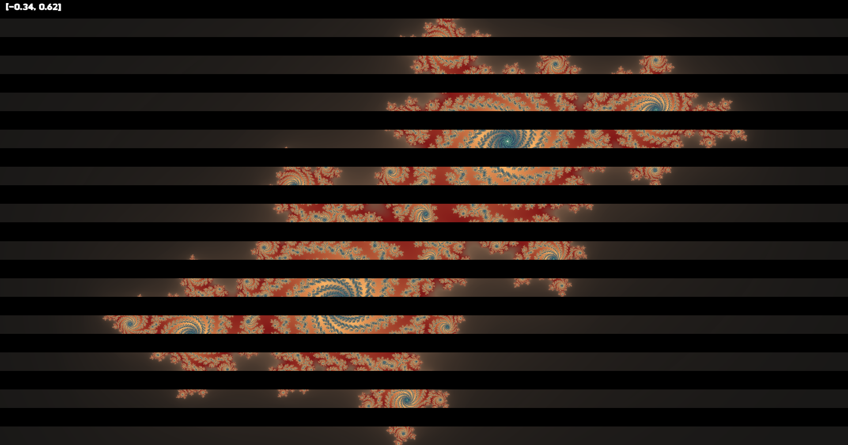
Code Review
Gradients
Julia iteration functions
  Rough iterates
  Smooth iterates
Anti-aliasing
Optimization

Slide 23
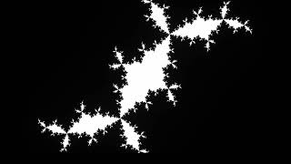
Video Demo (-0.8,0.0) ∪ (0.8, 0.0)

Slide 24
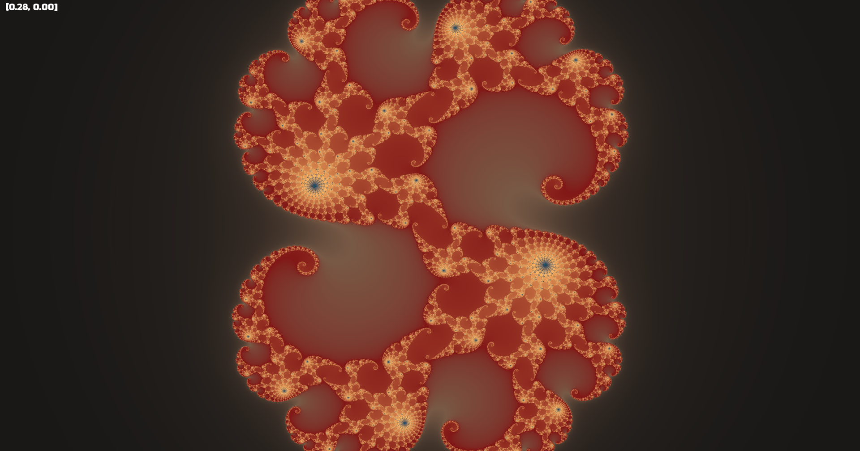
Thank You!
Questions?
C = 0.28 + 0.008i (max_iter = 500)

Slide 25
Credits
https://github.com/johnBuffer/JuliaRendering
https://www.sfml-dev.org/index.php
https://www.karlsims.com/julia.html#:~:text=Julia%20set%20fractals%20are%20normally,gives%20a%20specific%20Julia%20set.

